Slide 1

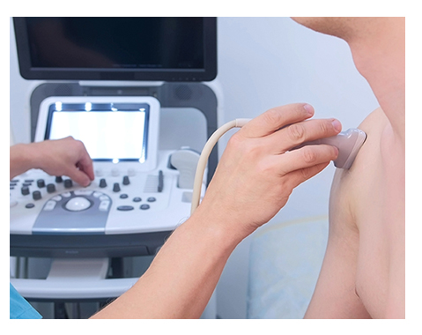
Name-
10th Qatar Musculoskeletal
Ultrasound Course
Monographic level

Slide 2

Application requirement
You are required to submit at least total 20 pathology images for the Shoulder, Elbow, Hand/wrist, Hip, Knee, Ankle/foot
  Size not more than 25MB

Slide 3
Application requirement
Please use the following powerpoint slides to insert the legend to the examination of the different joint regions.
To add more slide pages, please «Copy and Paste» the slides to insert similar slides.
Thank you!

Slide 4
Application requirement
The scans per joint regions should include all relevant structures learned in the Basic/Intermediate courses.
The EULAR Ultrasound Scanning Guide can be used as a reference. [http://ultrasound.eular.org/#/home]
Each slide must include both a longitudinal and transverse ultrasound scan demonstrating a particular anatomical structure
Each ultrasound image should include the initials of the bony landmarks and the most relevant structures that appear in the scan
A legend to the scan must be provided, including the anatomical area and scanning plane
Images must not contain patient data.

Slide 5
Application requirement
Check before you send:
  Is the essential information presented?
  Do slides ONLY show relevant data (remove all other)
  Make sure NO patient data is shown
  Have you included both a longitudinal and a transverse scan? important for evaluation
  Plain, white background slides are preferred

Slide 6
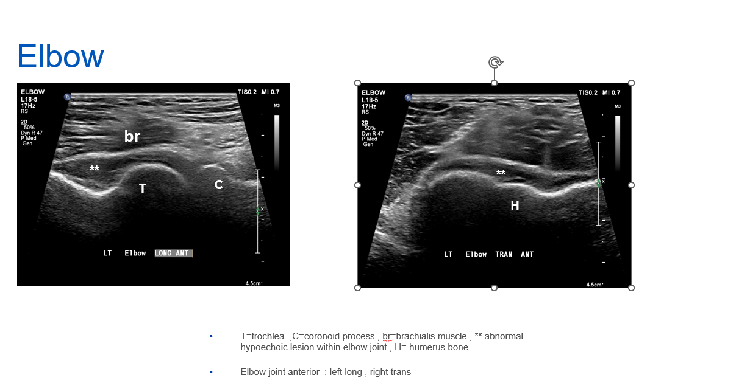
Example

Slide 7

Shoulder
Description

Slide 8
Elbow
Description

Slide 9
Hand/Wrist
Description

Slide 10
Hip
Description

Slide 11
Knee
Description

Slide 12
Ankle/foot
Description

